Slide 1


Jitter Busters
Optimizing Standard Ubuntu for Low-Latency High-Frequency Trading
Team Members:
金融四 溫亮達 | 國貿四 駱宥驊 | 經濟四 蘇芷儀

Slide 2
Table of Contents
Introduction to High-Frequency Trading (HFT)
The Role of Operating Systems in HFT
Optimizing Standard Ubuntu for Low Latency
Experimental Design & Methodology
Data Results & Performance Analysis
Bridging the Gap: Academic vs. Industrial Standards

Slide 3

Research Goal: Eliminating OS Jitter
Explain The OS-HFT Connection
The Operating System is the hidden bottleneck. It sits between strategy logic and hardware, where every layer adds critical microsecond-level delays.
Experimental Objective
Systematically strip away OS privileges to push network latency to its physical limits.
Demonstrate how iterative tuning (Kernel bypass, Core isolation) minimizes jitter in a VM environment.
Ultimate Target: Zero Jitter

Slide 4



What is High-Frequency Trading (HFT)?
HFT is a specialized form of algorithmic trading characterized by high speeds, high turnover rates, and high order-to-trade ratios. It leverages advanced technology to execute thousands of orders in fractions of a second.
Core Characteristics
Ultra-Low Latency: Success depends on microsecond execution to beat competitors.
Market Making: HFT firms act as passive liquidity providers, earning small margins on high volumes.
Short-Term Horizon: Positions held for seconds/minutes; zero net exposure at day's end.
Volume-Based: Decisions triggered by "volume bursts" rather than clock-time.
Fact: HFT accounts for over 70% of U.S. equity market volume.

Slide 5

Simple HFT Strategy: Cross-Exchange Arbitrage
The Concept
Identify price discrepancies for the same asset across two different trading venues (Exchanges A and B) and exploit the gap before it vanishes.
The Execution Loop
Step 1: Monitoring - Continuously poll Order Books via ultra-fast binary protocols.
Step 2: Signal - Detected price gap: Price_A < Price_B (spread > transaction costs).
Step 3: Action - Simultaneously Buy on A and Sell on B in under 100 microseconds.
Step 4: Hedge - Neutralize exposure immediately to secure risk-free profit.
"Arbitrage accounts for a major portion of HFT volume, ensuring market efficiency by aligning prices globally within milliseconds."

Slide 6







Essential Elements of an HFT System
1. Strategy & Algorithm Logic
2. Bare-Metal Infrastructure
Quantitative models identifying micro-arbitrage or market-making opportunities. Decisions must be automated and data-driven.
High-frequency CPUs (overclocked) and specialized NICs (Solarflare) for sub-microsecond packet processing.
3. Proximity & Connectivity
4. Software & OS Optimization
Colocation in exchange data centers to minimize physical distance; using binary multicast feeds (ITCH/PITCH).
Kernel bypass (DPDK), core isolation, and "spinning" loops to eliminate context switching and OS jitter. This is where OS helps!
10Gbps
Zero
Tick-to-Trade
NIC Throughput
Jitter Target

Slide 7
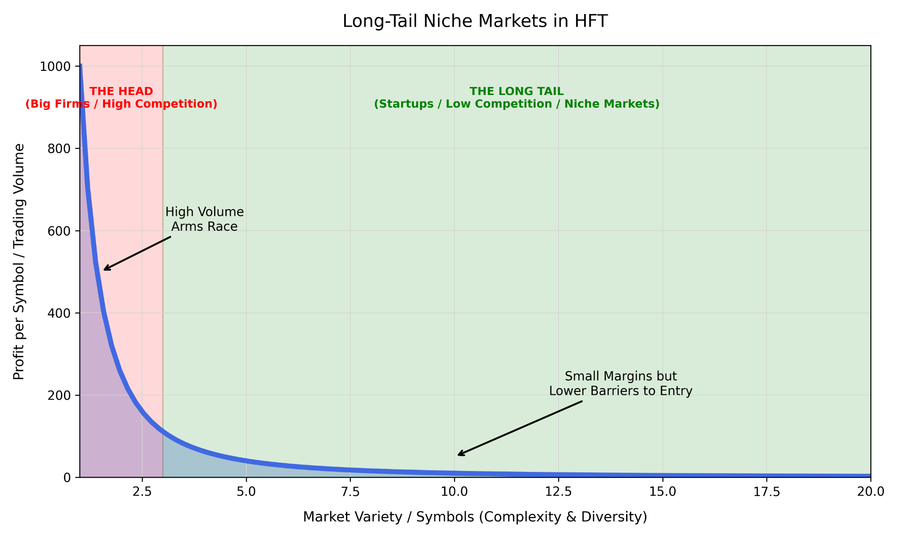
Democratic HFT: How Small Players Compete
Targeting "Long-Tail" Niche Markets
Focus on smaller symbols and scale strategies that institutional giants overlook due to high overhead costs.
Deep Software-Level Optimization
Micro-optimization of network stacks and OS kernels saves microseconds where hardware alone only saves nanoseconds.
Reduced Computational Load
Monitoring 5 targeted symbols instead of 500 allows for significantly lower processing latency and higher response speed.
Information Asymmetry over Speed
Leveraging "private fills" and modeling predictable big-firm behaviors allows profit without needing absolute top-tier speed.

Slide 8





The Role of OS in HFT: Optimization Targets
The OS is the hidden bottleneck. A trade decision must be executed within microseconds. The OS sits between your strategy logic and the hardware—every layer it adds costs time.
1. Real-Time Kernel (PREEMPT_RT)
2. Core Isolation (CPU Pinning)
3. Tickless Mode (nohz_full)
Dedicated CPU cores are reserved exclusively for the trading process—no other task may enter.
Disables timer interrupts on isolated cores, eliminating periodic jitter entirely.
Ensures the trading thread always gets the CPU immediately, without being preempted by system tasks.
4. Kernel Bypass (DPDK/OpenOnload)
5. Memory Locking (mlockall + HugePages)
All trading memory is pinned in RAM. No page faults, no swapping to disk.
Network packets go directly from NIC to userspace, skipping the OS network stack. Reduces latency:

Slide 9

"Break the fairness principles of a general-purpose OS and forge an extreme, dictatorial performance beast."
A standard Linux system is riddled with context switches, page faults, and network stack overhead. This project applies kernel-level modifications to strip Ubuntu down to the bone for microsecond-level trading.

Slide 10




Standard Linux Design Flaws for HFT
Context Switches
Page Faults
Network Stack Overhead
Our optimization stripped these away to forge an extreme performance environment.

Slide 11

Design of Experiments
Main Goal
Systematically strip away OS privileges to push network latency to its physical limits and achieve zero jitter.
Architecture Setup
Isolated Network: Established an isolated Internal Network to eliminate external broadcasts and background noise.
Ping-Pong Testing: Client: Acts as the sender (eg. exchange’s server sending prices info), firing packets in micro-bursts and recording the RTT. Server: Acts as trader’s HFT receiver where our OS modifications were applied.
Evaluation Metrics
Average RTT (Round Trip Time) and P99 RTT (the time within which 99% of packets are processed).

Slide 12
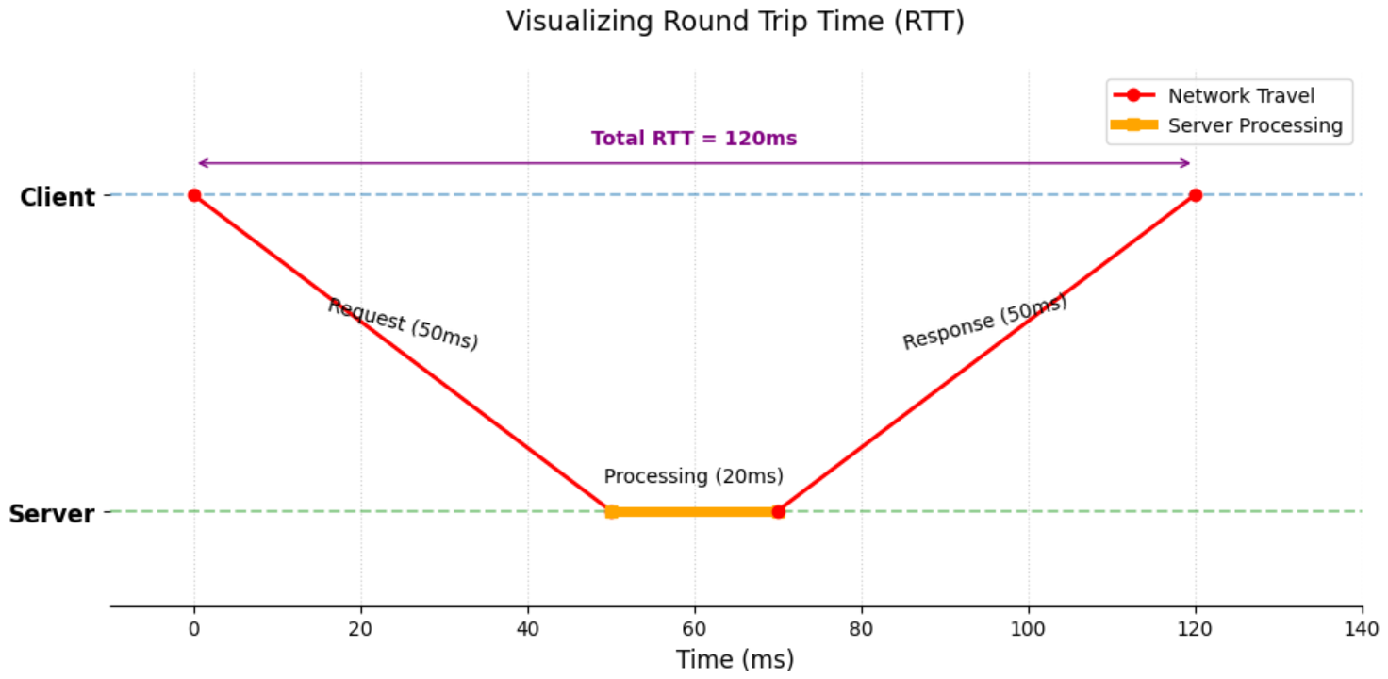
Round Trip Time (RTT)
RTT (Round Trip Time) is the total duration from the moment a data packet is sent from the client, until the corresponding acknowledgment or response is received back by that client.

Slide 13


Phase 0: Baseline
Architecture Setup
Dual-Machine: Two Ubuntu Desktop (GUI) virtual machines.
AVERAGE RTT
Protocol: Standard C++ UDP Sockets for Ping-Pong testing.
Network Management: Relies on high-level NetworkManager.
P99 RTT
Design Purpose
Establish a control group to measure unmodified performance.

Slide 14

Phase 1: Pure Server Version
Adjustments
Scenario | Avg RTT (μs) | P99 RTT (μs) | Max RTT (μs)
Baseline | 3527.84 | 21802.33 | 97642.6
Phase 1 | 1977.96 | 7059.63 | 125567.0
System Replacement: Abandoned Desktop GUI; rebuilt two text-only Ubuntu Servers.
Network Downgrade: Switched to the lightweight networkd.
Design Purpose
Eliminate Noise: GUI and bloated services generate massive Context Switches and hardware interrupts.
Protect Resources: Prevent CPU resources from being randomly hijacked by the system.

Slide 15

Phase 2: CPU Core Isolation & Pinning
Adjustments
Scenario | Avg RTT (μs) | P99 RTT (μs)
Baseline | 3527.84 | 21802.33
Phase 1 | 1977.96 | 7059.63
Phase 2 | 1752.06 | 6813.96
Kernel: Installed linux-lowlatency kernel.
OS Isolation: Modified GRUB (isolcpus) to remove Core 2 and 3 from the OS scheduler.
Program Binding: Added sched_setaffinity to force Server program exclusively on Core 2.
Design Purpose
Standard Linux bounces tasks between cores, causing CPU cache (L1/L2) invalidation. Core pinning gives the HFT program a "VIP Suite" with exclusive resources.

Slide 16
Phase 3: Memory Locking & HugePages
Adjustments
Scenario | Avg RTT (μs) | P99 RTT (μs)
Phase 1 | 1977.96 | 7059.63
Phase 2 | 1752.06 | 6813.96
Phase 3 | 1584.01 | 5191.88
System Level: Forcibly disabled Swap (swapoff -a) and enabled 512 2MB HugePages.
Program Level: Added mlockall function and executed with Root privileges.
Design Purpose
Eradicate Page Faults: Moving memory to Swap spikes latency to milliseconds.
Lock Physical RAM: Data always remains in fastest memory.
Accelerate Lookups: HugePages reduce TLB Misses (CPU dictionary lookups).

Slide 17


Phase 4: AF_XDP Kernel Bypass
Hardware: Switched to eBPF-supported virtio-net.
Network: Static ARP Binding (breaks "ARP Blackhole").
Software: Abandoned Sockets; used libxdp for UMEM. Custom C logic to parse headers and swap MAC/IP.
Defense: Microsecond braking (usleep) & Timeout fault tolerance to prevent virtual NIC overflow.
Design Purpose
Standard Linux TCP/IP stack is too thick. We achieved Zero-copy, allowing packets to reach User Space directly, completely eliminating OS intervention.
Phase 3 | 1584.01 μs | 5191.88 μs
Phase 4 | 961.31 μs | 1774.26 μs

Slide 18
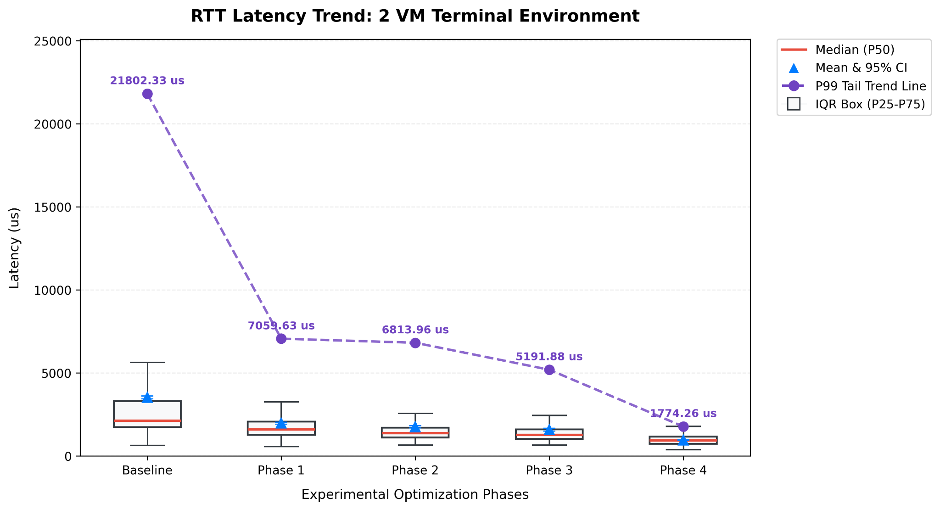
Results: RTT Latency Trend (VM Environment)
P99 RTT (Tail Latency)
Average RTT

Slide 19


Troubleshooting - Why a Single-VM Setup Failed
The Loopback Illusion
Failed Single-VM Data (Notice the escalating jitter)
Testing on a single machine is merely a memory copy. It bypasses real/virtual NIC drivers, making it impossible to validate AF_XDP hardware queue operations.
Scenario | Avg RTT (μs) | P99 RTT (μs) | Max RTT (μs)
Baseline | 101.88 | 346.25 | 1721.88
Phase 1 | 312.71 | 3373.72 | 54308.70
Phase 2 | 1623.15 | 6792.73 | 37657.30
Phase 3 | 1523.60 | 9037.76 | 241080.00
Resource Contention
Placing the sender and receiver on the same VM causes them to fight for CPU and interrupt processing.
The resulting "self-inflicted" jitter completely masks the true gains of the optimizations.

Slide 20
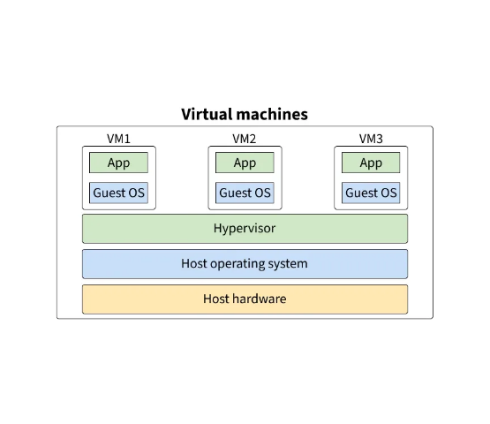
Bridging the Gap: Academic vs. Industrial
Our Project (VM Environment)
Used Virtual Machines for experimental flexibility.
Hypervisor Latency: The abstraction layer introduces unavoidable micro-delays and jitter.
Industrial HFT (Bare-Metal)
Hardware: Liquid-cooled, overclocked Bare-Metal (e.g., all cores locked at 5.5GHz+).
Deep BIOS Tuning: C-States disabled (no wake-up latency), Hyper-Threading OFF (prevents cache pollution), strict NUMA binding.
Hardware-Level Bypass: AMD Solarflare NICs map hardware directly to C++ memory. FPGAs bake trading logic directly into programmable NIC chips—executing in nanoseconds.

Slide 21
Questions?
Thank you for your attention!
High-Frequency Trading OS Optimization Project

